Slide 1
Fiscal Year 2021
Amended Budget Presentation
June 23, 2021

Slide 2
Arbor Park School District 145 Mission
Our mission is to develop a partnership with students, staff, parents, and the community that will create a learning environment that enables all children to reach their full potential and to ensure quality and equity for all to succeed.

Slide 3
2020/21 Administration Team
Dr. Andrea Sala – Superintendent of Schools
Dr. Brian O’Keeffe – Assistant Superintendent of Finance/CSBO
Ms. Gina DioGuardi – Director of Special Education
Ms. Camille Hogan – Director of Teaching and Learning
Mr. David Evans – Principal, Arbor Park Middle School
Mr. Bradley Dizonno – Assistant Principal, Arbor Park Middle School
Mrs. Eliza Santos-Lopez – Principal, Kimberly Heights School
Mr. Tom Flynn – Principal, Morton Gingerwood School
Mr. Scot Pierce – Principal, Scarlet Oak School

Slide 4
What Purpose Does The Budget Serve?
Meet requirements imposed by Illinois law and other applicable Federal & Local regulations.
Provides expending and taxing authority.
Satisfies a minimum level of financial information for state, local and the federal government.
Provide community direction as to BOE spending priorities.

Slide 5
2020-21 Budget Focus
Maintaing Clean, Safe and Disinfected Environments
- Building entrance, exit and usage plans for staff and students.
- Large purchases of PPE/Health Certification Programs to support staff and student wellness.
- Add non-traditional staffing patterns (Bus Aides/Temporary Cleaning Assistance)
- Extensive purchases of specific cleaning/disinfecting tools for school buses, bathrooms and large common areas.
Teaching & Learning / Technology Focus for 1:1 Remote Learning and Updated Parent Experiences
- Professional Development for Staff (Remote Learning/CPS).
- New Software Platforms (ALMA, ParentSquare, MyOn, Freckle, InSync (Wit & Wisdom) and TCI (History Alive!)
- Purchase Microsoft Surface Go’s for 1st and 2nd grade students.
- Purchase 1:1 Devices for All District Staff.
Continued Focus on L-Term Facility Goals and Fiscal Consistency
- Additional planning for Phase II roof work at APMS (Summer 2021).
- Infrastructure planning for a new school building (4-6 years).

Slide 6
2020/21 Amended Revenue %’s (Not including WC Abatements)
51.26% - Ad Valorem Taxes (Property)
1.96% - Other Local Revenues
29.86% - Evidence Based Funding
4.89% - Restricted State Grants
12.03% – Restricted Federal Grants

Slide 7
2020/21 Amended Operating Expenditure %’s
50.93% - Salaries
13.96% - Employee Benefits
13.10% - Purchased Services
7.69% - Supplies & Materials
12.53% - Capital Outlay
1.79% - Other Objects

Slide 8
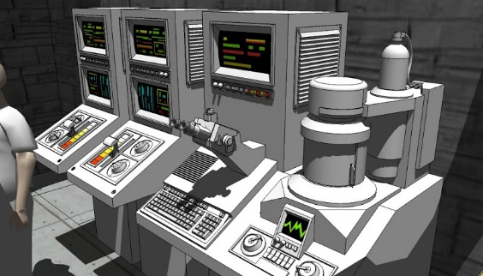
Posted Compensation Tables
Public Act 096-0434 – Administrative Compensation Report
- (FY21 Reported)
Public Act 097-0609 – IMRF Compensation Report
- (FY21 Reported)
Illinois Compiled Statute (105 ILCS 5/10-20.47) – Administrative & Teacher Report
- (FY21 Reported)

Slide 9
2020/21 Amended Budget Recap by Fund

Slide 10
Next Steps
Approve Amended Fiscal Year 2021 Budget
- June 23, 2021
Continue Working Fiscal Year 2022 Budget
- Today through August 2021

Slide 11
QUESTIONS??

