Slide 1
Fiscal Year 2020
Amended Budget Presentation
May 20, 2020

Slide 2
APSD #145 Mission
Our mission is to develop a partnership with students, staff, parents, and the community that will create a learning environment that enables all children to reach their full potential and to ensure quality and equity for all to succeed.

Slide 3
2019/20 Administration Team
Dr. Andrea Sala – Superintendent of Schools
Dr. Brian O’Keeffe – Assistant Superintendent of Finance/CSBO
Ms. Gina DioGuardi – Director of Special Education
Ms. Camille Hogan – Director of Teaching and Learning
Mr. David Evans – Principal, Arbor Park Middle School
Mr. Bradley Dizonno – Assistant Principal, Arbor Park Middle School
Mrs. Eliza Santos-Lopez – Principal, Kimberly Heights School
Mr. Tom Flynn – Principal, Morton Gingerwood School
Mr. Scot Pierce – Principal, Scarlet Oak School

Slide 4
What Purpose Does The Budget Serve?
Meet requirements imposed by Illinois law and other applicable Federal & Local regulations.
Provides expending and taxing authority.
Satisfies a minimum level of financial information for state, local and the federal government.
Provide community direction as to BOE spending priorities.

Slide 5
2019-20 Budget Focus
Increasing Student and Staff Academic Supports
- Using Evidence Based Funding appropriations for “lost” positions and additional instructional assets.
- Establishing a Teaching and Learning Department.
- Introducing new curriculum to staff and students.
- Institute for Excellence in Writing (IEW)
- Math in Focus
- Wit & Wisdom
- 1:1 Initiative Rollout at SOS and APMS.
- Camera and Security Enhancements in all facilities
Developing Long-Term Facility Goals and Fiscal Consistency
- Infrastructure planning for new roof at APMS.
- Infrastructure planning for a new school building (5-7 years).

Slide 6
2019/20 Budgeted Revenue %’s
53.40% - Ad Valorem Taxes (Property)
3.92% - Other Local Revenues
32.34% - Evidence Based Funding
4.30% - Restricted State Grants
6.04% – Restricted Federal Grants

Slide 7
2019/20 Budgeted Operating Expenditure %’s
57.36% - Salaries
17.08% - Employee Benefits
11.58% - Purchased Services
6.36% - Supplies & Materials
4.94% - Capital Outlay
2.68% - Other Objects

Slide 8
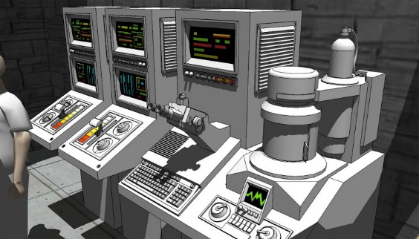
Posted Compensation Tables
Public Act 096-0434 – Administrative Compensation Report
- (FY20 Reported) – Same as September 2019 Table
Public Act 097-0609 – IMRF Compensation Report
- (FY20 Reported) – Same as September 2019 Table
Illinois Compiled Statute (105 ILCS 5/10-20.47) – Administrative & Teacher Report
- (FY20 Reported) – Same as September 2019 Table

Slide 9
2019/20 Amended Budget Recap by Fund

Slide 10
Next Steps
Post Amended Fiscal Year 2020 Budget
- May 21, 2020
Develop Tentative Fiscal Year 2021 Budget
- June 10, 2020
Approve Tentative Fiscal Year 2021 Budget
- June 24, 2020
Approve Amended Fiscal Year 2020 Budget
- June 24, 2020
Submit Approved Amended Fiscal Year 2020 Budget to ISBE
- No later than June 30, 2020
Approve Fiscal Year 2021 Budget
- September 23, 2020

Slide 11
QUESTIONS??

